Slide 1
9.6 Warm-up
If and A and B are mutually exclusive, then n(A or B) = ?
If A and B are not mutually exclusive, then n(A or B) = ?
The number of combinations of five objects taken three at a time is _____?
The number of permutations of five objects taken three at a time is _____?
Why is the number of permutations greater than the corresponding number of combinations?
What is the definition of a residual?
Write the exact value (no decimals) of sin⁻¹ 0.5.
$Y = 5∙3^{x}$is the particular equation of a(n) _______.
The area of a triangle with sides 5 cm and 3 cm and included angle 30⁰ is _____?

Slide 2
Complementary probabilities (not …)
If there is a 60% chance of rain, what is the percent it won’t?
Complementary: 1 – probability
Remember:
P(A) * P(B|A)
P(A) + P(B) – (P(A)*P(B))
Independent and Mutually exclusive

Slide 3
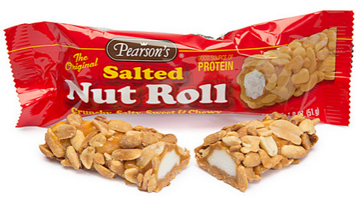
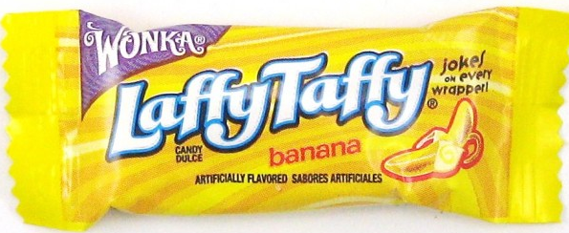
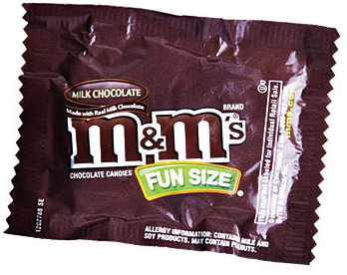
Union of events
A bag of candy contains
21 Laffy Taffy
23 Snickers
19 M&Ms
13 Salted Nut Rolls
Probability of picking a Laffy Taffy or a Snickers
Probability of picking candy with chocolate or nuts

Slide 4
Probability- intersection of 2 events
$P(B|A)$ is the probability that B occurs after event A has already occurred.
If A and B are mutually exclusive
$P\left(A and B\right)=P(A \bigcap_{ }{B}\text{)}\text{ =} P\text{(}\text{A}\text{) }∙P(B|A)$
If A and B are independent events
$P\left(A and B\right)=P(A \bigcap_{ }{B}\text{)}\text{ =} P\text{(}\text{A}\text{) }∙P(B)$

Slide 5
Example
Annie and Andrew volunteer in the children’s ward of a hospital. The probability that Annie gets the mumps is P(A) = 13%. The probability that Andrew gets the mumps is P(H) = 7%. Find the probability that:
Both catch mumps
Annie doesn’t catch mumps
Andrew doesn’t catch mumps
Neither catches mumps
At least one catches mumps

