Slide 1
9.4 Qs
If the outcomes of a random experiment are equally likely, then the probability of an event is defined to be ______? (hint: it’s a formula)
If events A and B are mutually exclusive, then n(A or B) = ______?
If events A and B are NOT mutually exclusive, then n(A or B) = _______?
The set of all possible outcomes of a random experiment is called the ______.

Slide 2
9.4 Warm-up (con’t)
_____ functions have the multiply-multiply property.
The slope of the linear function 4x + 5y = 40 is _______?
The “If” part of a theorem is called the _____.
An equation that is true for all values of the variable is called a(n) ________.
4% of 700 is ________.

Slide 3
Permutations
According to Sheldon:
The sandwich is a permutation
The order matters to him
How many different ways can Sheldon’s sandwich be permutated?
Turkey
Roast Beef
Lettuce
Swiss
What’s the probability the restaurant will get it right?
Key words: arrange/order

Slide 4
Permutations
Ex: In how many diff. ways could I arrange 3 of the 12 pictures of my family on my wall?
_____ * _____ * _____
Ex: Given the word SPACE, how many ways can you arrange the letters
___ ___ ___ ___ ___

Slide 5
Repeated Elements
Ex: Given the word SPARTANS, how many ways can you arrange the letters
___ ___ ___ ___ ___ ___ ___ ___

Slide 6
Repeated Elements
Ex: Given the word SPARTANS, what is the probability that a permutation of the word will have a ‘P’ as the 4th letter and a vowel as the last letter?
___ ___ ___ ___ ___ ___ ___ ___

Slide 8

Using the calculator for Permutations
$$_{n}P_{r}$$
Ex: In how many diff. ways could I arrange 3 of the 12 pictures of my family on my wall?
_____ * _____ * _____
Ex: Given the word SPACE, how many ways can you arrange the letters
___ ___ ___ ___ ___

Slide 9

Using the calculator for Permutations
One hundred people purchase raffle tickets. Three winning tickets will be selected at random. If first prize is $100, second prize is $50, and third prize is $10, in how many different ways can the prizes be awarded?
$$_{n}P_{r}$$

Slide 10
Does the order matter?
7 of the 50 students’ QTs turned in will be randomly selected for grading. How many different ways are there to make this selection?

Slide 11
Combination v. permutation
Permutations are an ordered list
Order is important
Selected objects should be treated differently
Key words – order or arrangement
Combinations are unordered lists
The order of selection is irrelevant
Selected objects are treated the same
Key word – group

Slide 12
Total number of elements in the set
“n Permutate r”
or
“n arrange r”
Number of elements not selected

Slide 13
Total number of elements in the set
“n choose r”
Number of elements selected
Number of elements not selected

Slide 14
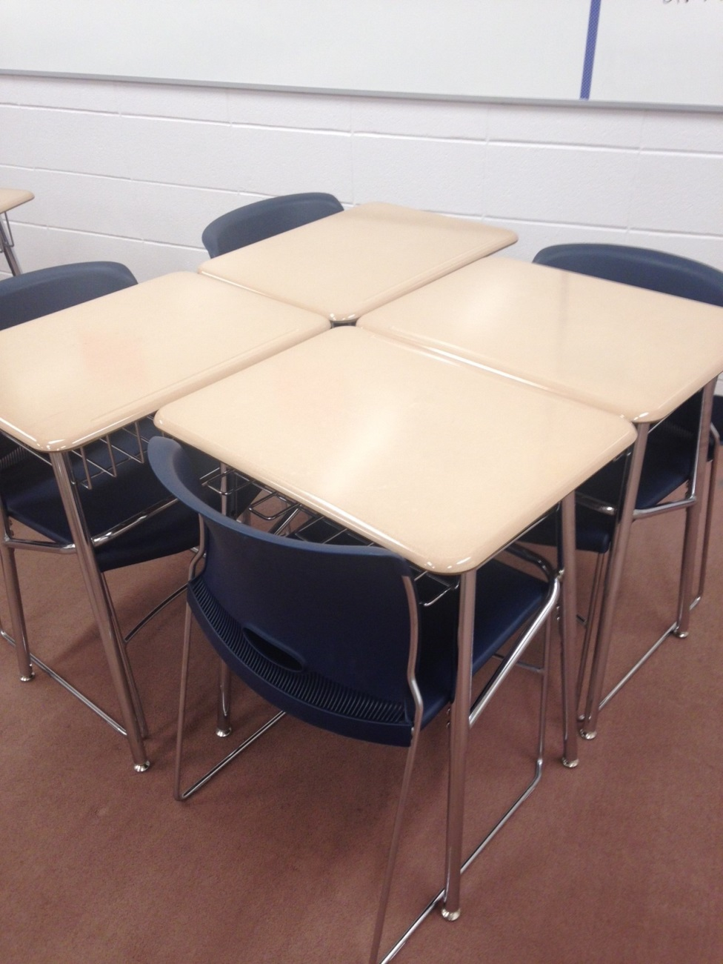
Seating chart
How many ways can I arrange this set of chairs with students from this class?
How many different 4 person teams can I make from the students in this class?

Slide 15
Seating chart
What is the probability that this group will be all girls?
What is the probability that this group will have 3 girls and 1 boy?
What is the probability that this group will have 2 boys and 2 girls?

